Slide 1




How To Conduct An
Administrative Inquiry (AI)
Due To A Security Violation
www.dss.mil

Slide 2
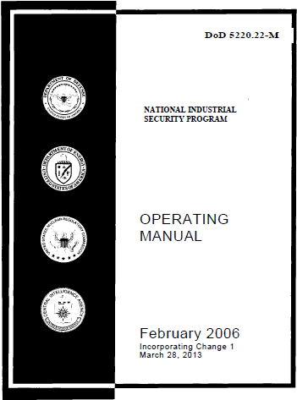
Security Violations
Can this happen in your facility?
Has this happened in your facility?
When will this happen in your facility?
“It is a requirement of the NISPOM and your duty as FSO to report Security Violations.”
NISPOM paragraph 1-303

Slide 3

Introduction and Objectives
Why Me? Gary S. Layne, Sr. Industrial Security Representative
Target Objective: Providing Facility Security Officers the key steps in conducting an Administrative Inquiry caused by a Security Violation to ensure that risks to classified information are mitigated.

Slide 4
Security Violation
Definition:
  A failure to comply with the policy and procedures established by the NISPOM that reasonably could result in the loss or compromise of classified information.
    DoD 5220.22-M (NISPOM)
Purpose of the Administrative Inquiry (AI):
  To determine if classified information was at risk of compromise
  To determine the individual(s) that are responsible for the violation.
  To determine if appropriate corrective actions have been taken to preclude a reoccurrence.

Slide 5

Mitigate The Risk
Has the FSO taken action to protect the classified material?
What is the extent of the violation?
Was classified information subject to loss or compromise?
Who was responsible for the violation?
What vulnerabilities caused the violation?
Did the FSO take the proper corrective actions?
What are the threats?
Notes:
Shutterstock: #184837817
Script: Once a security violation has been identified, DSS’s main goal is to mitigate, or assist industry in mitigating the risk to classified information. So, we ensure that a thorough inquiry is conducted to determine the root causes of the violation and to ensure that classified information is protected. Here are some of the questions we’ll need to get answered during that inquiry.

Slide 6
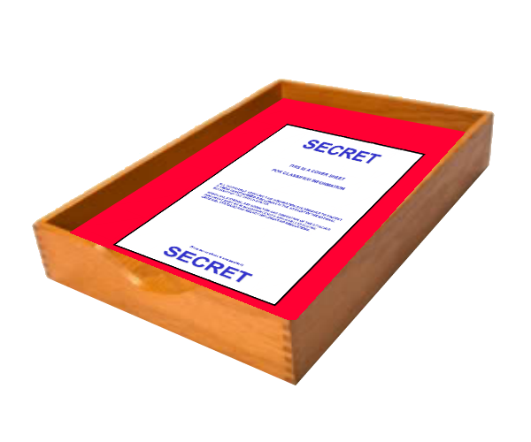
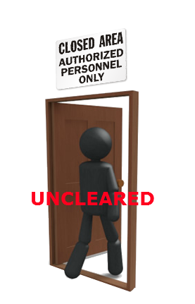

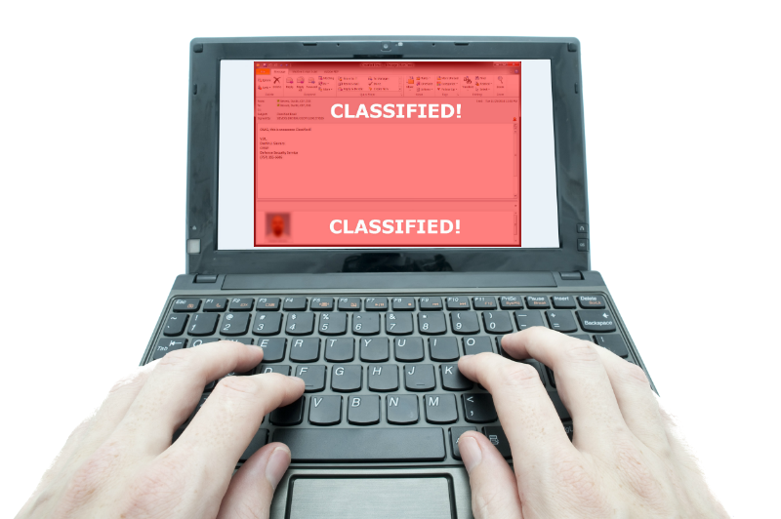
Types of Security Violations

Slide 7
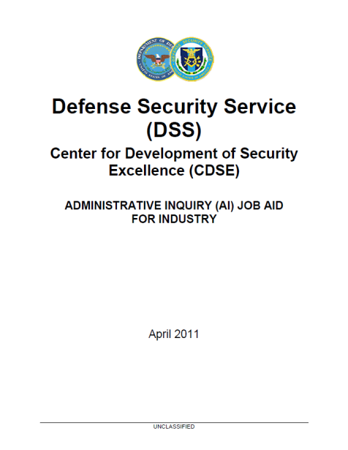
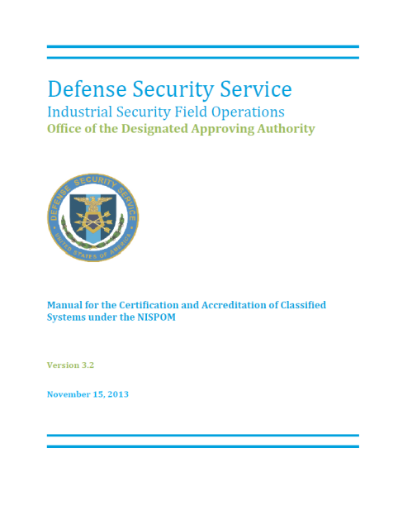
Tools needed to complete the Administrative Inquiry (AI)
Obtain the tools to conduct the AI.
  FSO Toolkit:
    Administrative Inquiry (AI) Job Aid For Industry
  Information Systems
    ODAA Process Manual
      Section 4.5.1

Slide 8





The Security Violation Process
Goal to process: 30 days
FSO: 1 – 2 days
ISR:
3 days
FSO: 15 days
ISR: 5 days
FOC:
5 days
Security
Violation
Inquiry
and Determination
Field Office Chief Approval
Preliminary
Inquiry
Initial Report
Final Report
Violation Closure
Conduct inquiry and develop reports
Review reports and provide support
ISR
FSO
Notes:
Shutterstock: 54052987 and 88280167
<Be sure to put ISOM7 and Security Violation Quick Reference into the Files pod>
Script: This is the overall process for handling industry reported security violations, as specified by the new ISOM, Module 7 update. As you can see, the overall goal of completing the security violation within 30 business days has not changed, but we have added clarity about processing timelines.
Typically, when a security violation is reported by the contractor, the Facility Security Officer (FSO) conducts the inquiry and prepares reports. The DSS Industrial Security Representative (ISR) reviews the reports and supports the FSO throughout the process.
It’s important that we apply this process consistently for all facilities to help avoid confusion and to process security violations as efficiently as possible. For the rest of this session, we’ll discuss the details of what happens at each step of this process for contractor-reported security violations.
Everything you need to know about processing security violations is provided in the ISOM, Module 7. You can download this document from the Files pod now, as well as a Security Violations Processing Quick Reference Guide. Take a moment now to download these for reference as you complete this course.

Slide 9

Conducting a Preliminary Inquiry
FSO: 1 – 2 days
Security
Violation
Inquiry
and Determination
Field Office Chief Approval
Preliminary
Inquiry
Initial Report
Final Report
Violation Closure
ISR has 3 days to process
No Compromise
Secure classified information
Gather facts
Determine if loss, compromise or suspected compromise
Identify vulnerabilities or continuing risk
Identify those involved
Finalize and retain report
Submit culpability report
Compromise
FSO
Continue the process
Notes:
Shutterstock: 63301114 and 141007126
Script: Let’s see what Bob, the FSO, will do to process this security violation. First, Bob conducts a preliminary inquiry to:
secure the classified information
quickly gather the available facts
determine if classified information was subject to a loss, compromise or suspected compromise
identify any vulnerabilities or continuing risk to classified information
identify the individuals, organizations, or companies involved
If, based on the preliminary inquiry, Bob concludes that no loss or compromise occurred, all he has to do is finalize the inquiry and retain the report and any attachments for review by the ISR during the next Security Violation Assessment. He may also have to submit culpability reports to the DoD Central Adjudication Facility. For no compromise situations, the FSO does not have to report the incident to the DSS field office. But because this is a data spill, Bob determines that there was a loss. What next?

Slide 10
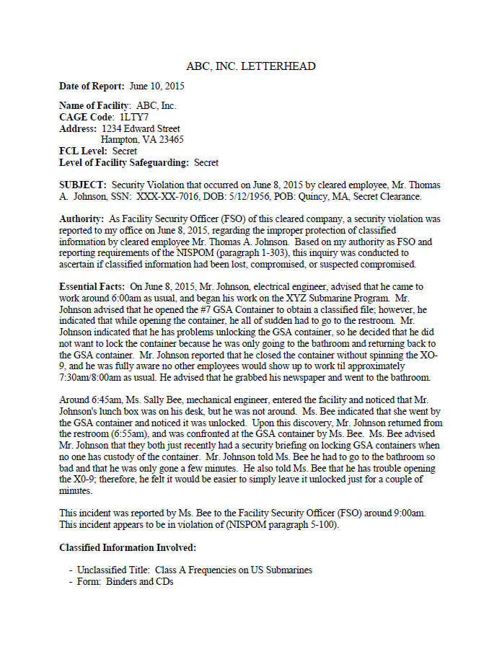
Sample of No Compromise
Sample of no compromise final report maintained in the facility and kept for review by the DSS Rep during the next assessment.

Slide 11
Submitting an Initial Report
FSO: 1 – 2 days
Security
Violation
Inquiry
and Determination
Field Office Chief Approval
Preliminary
Inquiry
Initial Report
Final Report
Violation Closure
ISR has 3 days to process
Initial Report
Description of Violation
Counterintelligence Concerns
Classification
Continuing risks or vulnerabilities
Other facilities
GCA POC
Confirmation that classified material is protected
Special category, if applicable
FSO
ISR
Notes:
Shutterstock: 54052987 and 88280167
Script: During his preliminary inquiry, Bob determines that there was a loss of classified information. So, he must PROMPTLY submit an initial report to DSS. <build on Sharon> Sharon is an ISR at the field office that oversees Bob’s facility. Bob sends Sharon his initial report. Sharon must ensure that the initial report contains sufficient information to generate initial notifications to the Government Contracting Agency (GCA) and other parties as applicable. <Build on report> Sharon reviews Bob’s initial report to ensure it includes:
-A description of the circumstances surrounding the violation—being careful not to disclose the location of the information
-Issues of counterintelligence concern when appropriate.
-The classification level of the information involved—except for data spills; so in this case the classification would NOT be included.
-Any continuing threats, vulnerabilities, or risk to classified information.
-Other facilities (CAGE) or locations that may have originated or received the violation.
-The GCA POC (email, phone, address) for the classified contract(s) associated with the violation including the prime contract number, program name, DD 254, and technology involved.
-Confirmation that immediate and appropriate actions have been taken to protect and secure classified information
-Statement if special category information (i.e. NATO, RD, FRD, CNWDI, FGI, etc.) is involved.
<build on ISR has 3 days text> Sharon must review and process the initial report within three days.

Slide 12
Initial Report
If it involves, Secret and Confidential:
  report to DSS within 72 hours (3 days)
If it involves, Top Secret:
  Within 24 hours (1 day)
  Sample of an initial report
  (send to IS Rep, FOC, CISA &
  ISSP if applicable)

Slide 13


Conducting the Inquiry
FSO: 15 days
Security
Violation
Inquiry
and Determination
Field Office Chief Approval
Preliminary
Inquiry
Initial Report
Final Report
Violation Closure
Facts
Possible causes
Persons responsible
Corrective actions
Unauthorized access to the classified information
FSO
Notes:
Shutterstock: 87219709
Script: After submitting his initial report, Bob continues his inquiry of the circumstances that led to the violation, identifying:
-the facts
-possible cause(s)
-person(s) responsible and determining culpability
-corrective actions taken or to be taken
-whether or not unauthorized personnel had, or could have had, access to the information
In short, the facility need to answer the who, what, when, where, and why questions. What the new update includes is some additional depth to those same questions. Find these questions in your ISOM and type a couple of them into chat. <Give participants a few minutes to look through the ISOM and type questions into chat. As you see correct questions, capture them on the whiteboard so that it looks something like the next slide.>

Slide 14
Final Report
Conducting AI for Final Report
  Inform senior management of the active administrative inquiry.
  Interview all personnel/witnesses involved in the violation:
    Employees
    Vendors
    Sub-contractors
    Visitors
    Consultants
  When appropriate, search workspaces, computer systems, emails, cell communications, etc….
  Gather and analyze all facts
  Prepare final report for DSS

Slide 15
Baseline Questions
Baseline Questions for the Inquiry (Remember to use the AI Job Aid for Industry)
Who discovered and reported the incident?
What corrective actions were taken?
What specific classified information and/or material was involved and what is the classification level of the information? Was the information properly classified?
What steps were taken to locate the material if classified information is alleged to have been lost?
What specific NISPOM references were violated?
What persons, situations, or conditions caused or contributed to the incident?
When did the incident occur and when was the classified information secured?
Where did the violation originate and was the classified information further disseminated or circulated (i.e. data spill)?
Why did the incident occur? Is there a weakness or vulnerability in established security practices and procedures that contributed to the incident or violation? Was there a specific failure to comply with established security practices and procedures that could lead to compromise if left uncorrected?
Did a lack of understanding of the SCG or applicable security guide contribute to the violation?
Notes:
Script: Good job! You’ve found in the ISOM, Module 7 the baseline questions that need to be answered during an inquiry. Let’s take a look at how Bob answered those questions for this security violation.
<Switch to the Security Violation Data Spill Answers.doc document that shows the answers to these questions for the scenario. Briefly summarize the answers to the questions. Also point out that additional questions are asked for Counterintelligence purposes, specifically to determine if the violation shows possible involvement with foreign country, espionage, sabotage, subversion or terrorism.>

Slide 16
Making a Determination
FSO: 15 days
Security
Violation
Inquiry
and Determination
Field Office Chief Approval
Preliminary
Inquiry
Initial Report
Final Report
Violation Closure
Loss
Compromise
Suspected Compromise
No Compromise
“Compromise Cannot
Be Ruled Out”
FSO
Notes:
Shutterstock: 59381590
Script: When Bob has completed his inquiry, he should be able to make a clear determination of whether the security violation has caused a loss, compromise, suspected compromise, or no compromise.
Per NISPOM requirements, these are the only determinations that can be used for security violations. The ISOM, Module 7 provides criteria for making the security violation determination. Take a look in your ISOM now and review the criteria, then decide what you think the determination should be for the security violation that Bob has been investigating. <Go to poll question. See next slide.>

Slide 17
Filing a Culpability Report
FSO: 15 days
Security
Violation
Inquiry
and Determination
Field Office Chief Approval
Preliminary
Inquiry
Initial Report
Final Report
Violation Closure
Final Report
Summary of Inquiry
Rationale for determination
Complete description of all circumstances leading to the violation
Culpability Report
Factual details
Risk of culpable person’s continued access to classified information
Notes:
Shutterstock: 52894672
Script: Does Bob need to submit a culpability report? Bob will only submit a Culpability Report in JPAS if he believes the person responsible for the security violation:
-Deliberately disregarded security requirements
-Was grossly negligent in the handling of classified material
-Has demonstrated a pattern of negligence or carelessness
Also, Bob can only submit culpability reports for his personnel, so in this case he would not submit a report in JPAS as Jennifer was the victim of the data spill, and the sender was from the Government.
If needed, the Culpability Report should contain clear, factual details about the culpable person’s actions and identify any security risk associated with that person’s continued access to classified information. These reports go in JPAS and are reviewed by PSMO-I before being sent to the DoD CAF

Slide 18
Reviewing the Final Report
ISR: 5 days
Security
Violation
Inquiry
and Determination
Field Office Chief Approval
Preliminary
Inquiry
Initial Report
Final Report
Violation Closure
Final Report
Essential Facts
Summary of Inquiry
Rationale for determination
Complete description of all circumstances leading to the violation
Corrective actions
Resolution
Culpability
FSO
ISR
Notes:
Shutterstock: 88280167
Script: When Bob has finished his inquiry, he completes a final report that:
-Presents essential facts and a summary of the inquiry.
-Provides a complete description of all circumstances that lead to the violation
-Corrective actions taken to protect classified information and to prevent a reoccurrence
-A conclusion outlining the resolution of the violation, including information used to arrive at his specific determination (loss, compromise, suspected compromise, no compromise)
-A determination of culpability for any individual deemed culpable for the violation
A sample final report is included in the ISOM and can be provided to the FSO as a guide for formatting. CDSE has also produced a job aid for security violations which can be provided and includes additional details about the process.
Back to the example: Bob submits his final report to Sharon, who reviews the final report and completes several actions to process it.

Slide 19
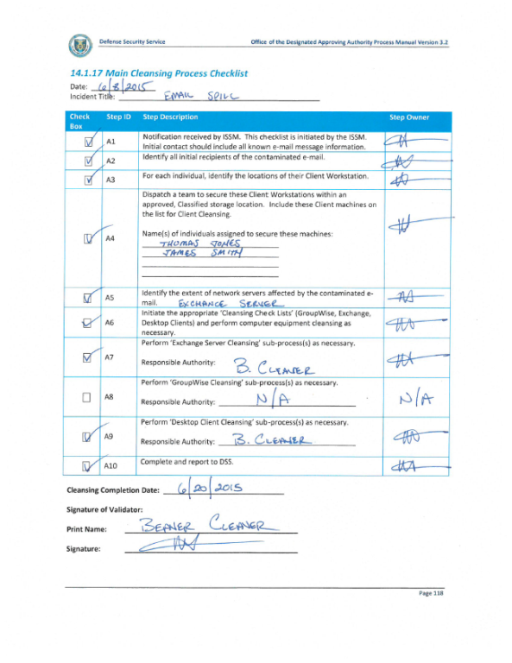
Sample of Final Report
Sample of Final Report & IS Checklist (if spillage).
(Send to IS Rep, ISSP, FOC & CISA)

Slide 20
Sample of Culpability Report
File Report Incident in JPAS
Sample of culpability report
  Faxed to PSMO-I
    (571) 305-6011
    NISPOM Paragraph
    (1-304)

Slide 21
Challenges & Reminders
Interviewing managers, peers, co-workers, etc…is very intimidating. Just remember, as the FSO…you are simply doing your job! Build rapport with the workforce and these security violations will be easier to handle!
Getting management support is crucial…so always communicate and educate Sr. Management on the reporting requirements of the NISPOM!
You are the Facility Security Officer (FSO) of this cleared facility, and have total control, management, and input of the administrative inquiry being sent to DSS caused by a security violation. When in doubt or have concerns, communicate with your DSS Representative!
Spillages are considered a “Loss”.
Cleared facilities shall establish and apply a graduated scale of disciplinary actions on culpable employee(s).
Insider Threat Program Requirements (soon to come)
Facility's security staff, FSO or the facility Key Management Personnel (KMP) are involved in the violation, the DSS REP will conduct the administrative inquiry (AI).

Slide 22


Consequences of Security Violations
Endanger the war fighter
Compromise Strategic Plans
Compromise Technological Knowledge
Loss of technological advantage
Harm Diplomatic Efforts
Cause death
Damage to national security
Notes:
Shutterstock: 34468900, overlaid with Shutterstock:
Script:
Lets start with the basics. Why do we even care about security violations? Why do we need a solid process for handling security violations? Well, think about what can happen when classified information is compromised. What are some of the consequences of security violations? Please type your answers into chat.
<Read off some of the answers in chat to highlight the consequences. Then click to build on bullets.>
A security violation when security has failed and the information that we strive to protect comprimised. The security violation process we’re going to go through today can help to reduce the risks when there is a security violation and help to eliminate these types of issues, ultimately improving our national security.

Slide 23



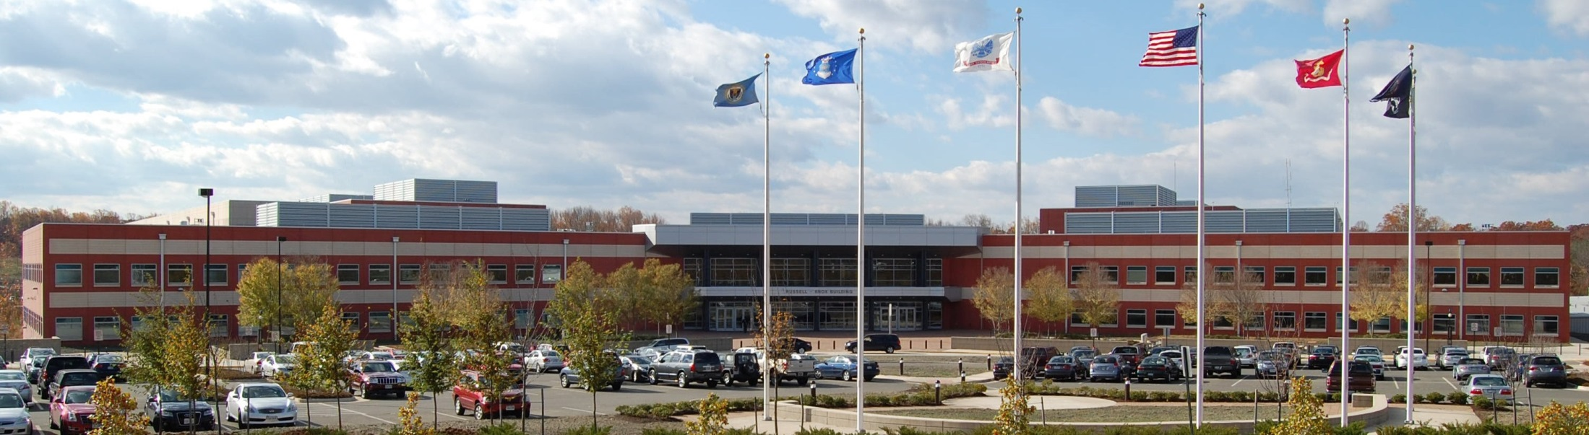
Questions?
gary.layne@dss.mil
(757) 355-6605
INDUSTRY

